Slide 1
Multi-Metal Recycling and Refining –
The Metallo Process
Slag Valorisation Symposium
Lars Cuyvers
Metallo Belgium, Beerse, Belgium

Slide 2
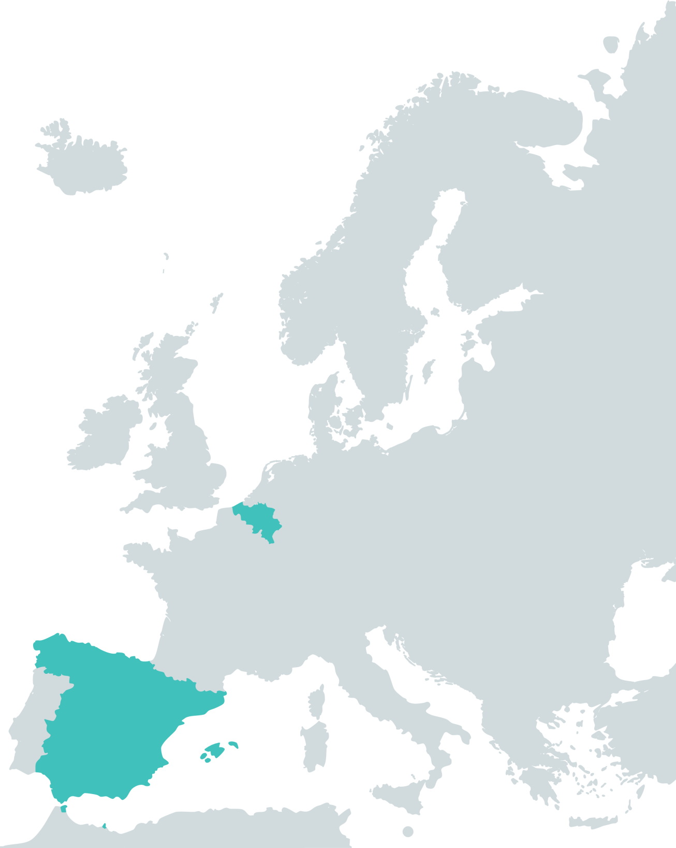

One group, two sites
Founded in 1919
±1 Billion EUR of revenue in 2017
450 employees at Metallo Belgium and 89 employees at Metallo Spain
Recycling 350 000 ton/a of low-grade and complex secondary scraps and residues
Returning high-grade metals and minerals into the value chain
Metallo Belgium
Metallo Spain
We close the loop

Slide 3
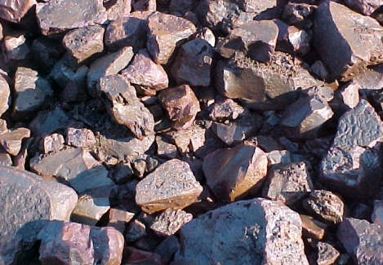
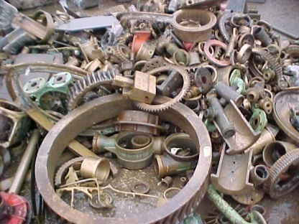
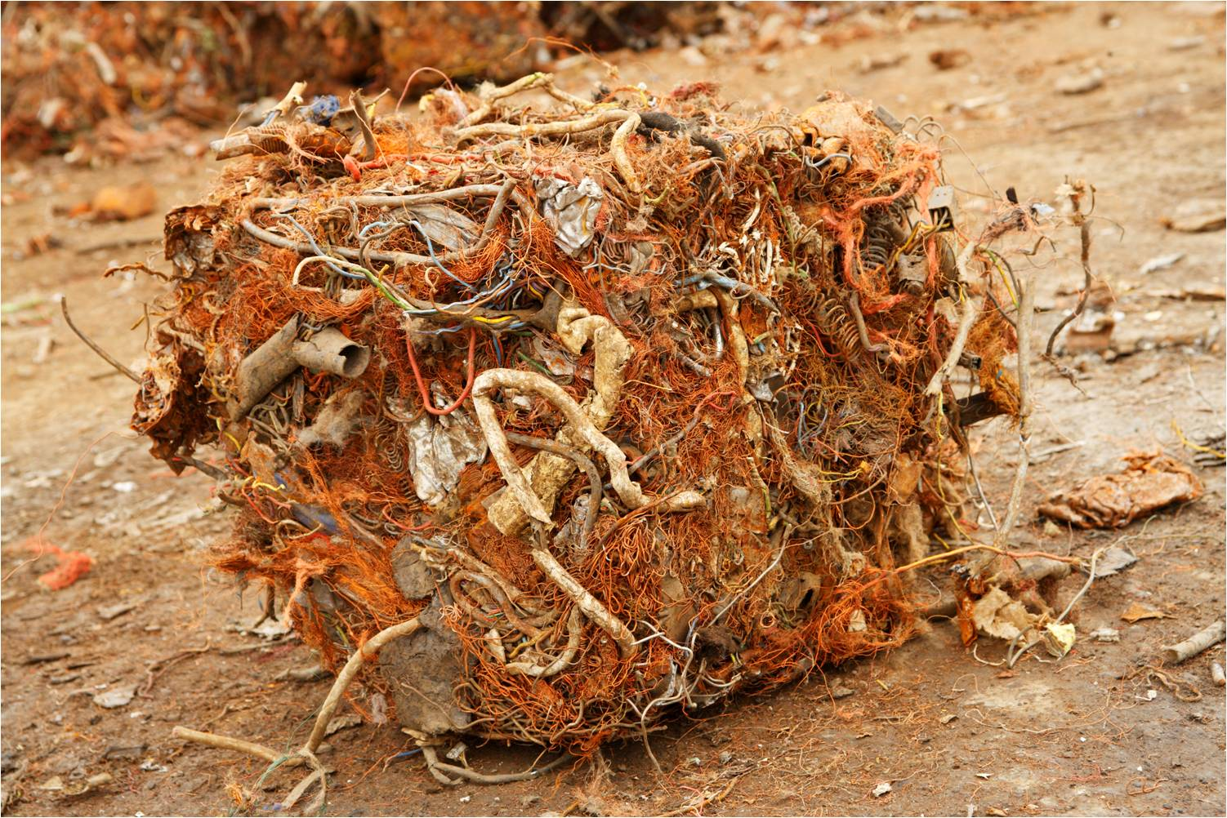
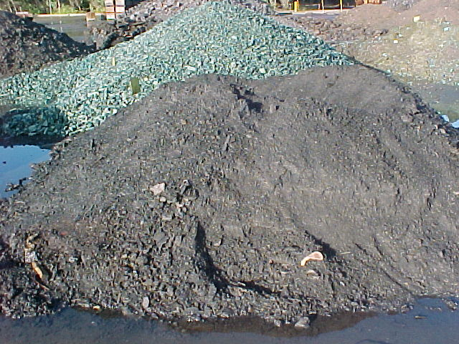
The Metallo process
We purchase and process secondary raw materials with relatively low copper, tin and/or lead content up to 99% copper, tin or lead content.
Traditional commodities like mixed copper, copper chops, heavy bus bars, …
Typical refinery grades ocean, ebony/gunmetal, alu-bronze, ref brass
More complex materials like residues and copper clad steel
A variety of oxidic and metallic tin containing materials

Slide 4

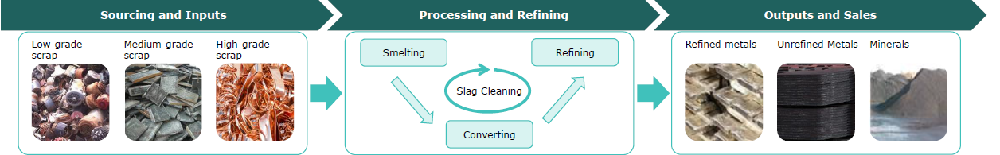
The Metallo process
100%
Secondary Materials
100%
Products
Post-Production
Post-Consumption
Refined Metals
Unrefined Metals
Minerals
We close the loop

Slide 5
The Metallo process
Refined Metals
Cu cathodes ‘B grade’
Sn ingots ‘M brand’
LME registered, Low Lead & ‘conflict free’
Pb ingots
Soft & Hard Lead on customer specifications

Slide 6
The Metallo process
Refined Metals
Unrefined Metals
Cu cathodes ‘B grade’, min. 99,97% Cu
Sn ingots ‘Metallo brand’, LME registered, Low Lead, CFSI compliant ‘conflict free’, min. 99,95% Sn
Pb ingots ‘Metallo brand’, soft lead min. 99,9%
Pb & hard lead on customer specifications
Cu anodes and Cu blister
Anode sludges
Nickel Sulphate Solution
Zinc Oxides

Slide 7
The Metallo process
Refined Metals
We close the loop
Unrefined Metals
Cu cathodes ‘B grade’, min. 99,97% Cu
Sn ingots ‘Metallo brand’, LME registered, Low Lead, CFSI compliant ‘conflict free’, min. 99,95% Sn
Pb ingots ‘Metallo brand’, soft lead min. 99,9%
Pb & hard lead on customer specifications
Minerals
ELMIX ®, Iron Silicate – Metallo Spain
REACH registered product
Cu anodes and Cu blister, ca. 99% Cu on customer specifications
Anode sludges
Nickel Sulphate Solution
Nickel Briquettes
Zinc Oxides
METAMIX ®, Iron Silicate – Metallo Belgium
REACH registered product
KORANEL ®, Clean synthetic mineral – Metallo Belgium
REACH registered product

Slide 8
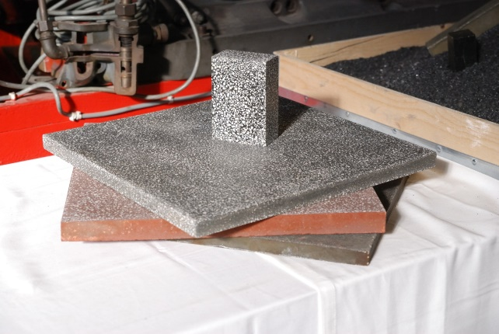
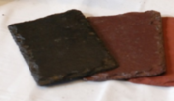
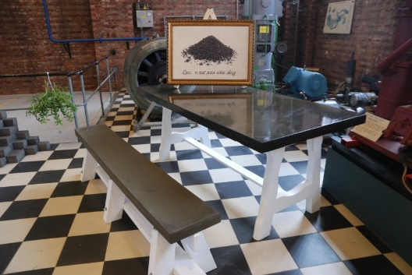
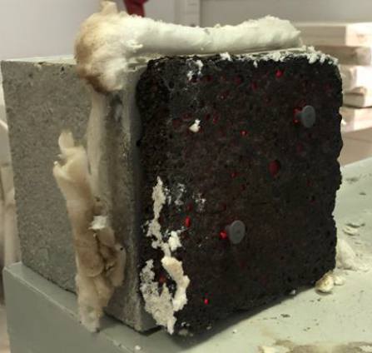
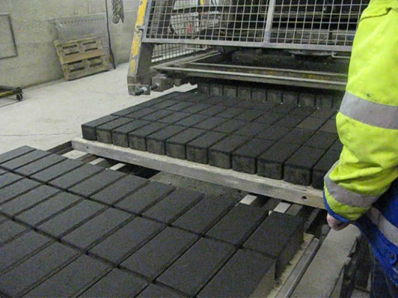
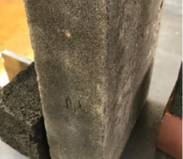
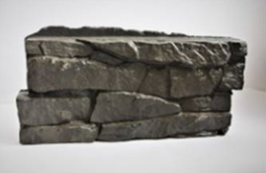
Product development

Slide 9
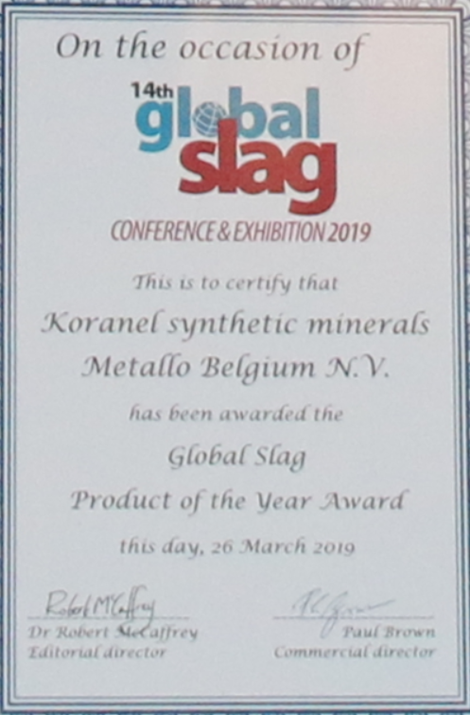
Product development

Slide 10
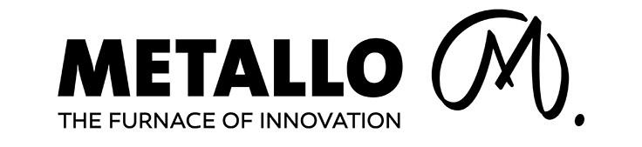
We’d love to get in touch
Visit our website
www.metallo.com

